Slide 1
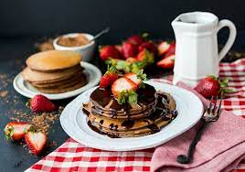
CAFÉ TABLE RESERVATION System
Batch-8

Slide 2
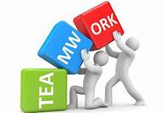
Batch -08
Front End
Yellaling 2492103
Vinayak Gunjikar 2492313
Yenni Anusha 2491164
Back End
Yash Pandey 2492460
Vipin (frontend) 2492122
Vishal Ramachandra Nalawade 2492153
Vipul Vivek Chinnawar 2492181

Slide 3
Agenda
Introduction
Objective
System Requirements
Tools & Languages Used
ER Diagram
Frontend tools
Application flow
Backend tools
Outputs
Features
Advantages and disadvantages
FutureScope
Conclusion

Slide 4
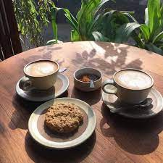
Introduction
Café table reservation is an Internet-based Java application that automates the working of a café that manage and maintain records of the customers.
The proposed project “Café Table Reservation” has been developed to overcome the problems faced in the practicing of manual system.
This web application is reduced as much as possible to avoid errors while entering data. It also provides error message while entering invalid credentials.

Slide 5

Objective
The Primary objective of the design is to deliver the requirement as delivered by the feasibility report. There are some objective we kept in mind.
Practically : The system is quite stable and can be operated by customers with average intelligence.
Efficiency : We tried to involve accuracy, timeliness and comprehensiveness of system output.

Slide 6

System Requirements
Angular, Postman and MySQL to be installed to the system
572 MB Random Access Memory
200 MB of Free Space on Hard Disk
Microsoft Windows or Linux or Equivalent OS
Web Browser

Slide 7

Tools & Languages
Front End
Back End
Visual Studio
Angular
HTML
CSS
BOOTSTRAP
Spring Boot
MySQL
Hibernate
Postman
Eclipse

Slide 8
E-R Diagram:
Login
Add item to menu
Admin
Remove item from menu
View feedback,user,menu,reserve table
Homepage
Register
Login
User
Choose ac/non ac room table
reserve table(ac/non ac)

Slide 9
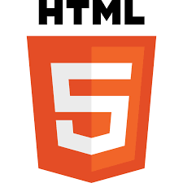
HTML
HTML stands for Hyper Text Markup Language
HTML is the standard markup language for creating Web pages
HTML describes the structure of a Web page
HTML consists of a series of elements
HTML elements tell the browser how to display the content
HTML elements label pieces of content such as "this is a heading", "this is a paragraph", "this is a link", etc.

Slide 10
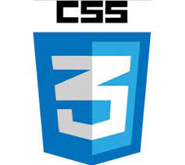
CSS
CSS stands for Cascading Style Sheets
CSS describes how HTML elements are to be displayed on screen, paper, or in other media
CSS saves a lot of work. It can control the layout of multiple web pages all at once
External stylesheets are stored in CSS files
CSS is used to define styles for your web pages, including the design, layout and variations in display for different devices and screen sizes.

Slide 11
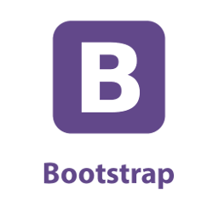
BOOTSTRAP
Bootstrap is the popular HTML, CSS and JavaScript framework for developing a responsive and mobile friendly website.
Our Bootstrap includes many topics such as jumbotron, table, button, grid, form, image, alert, wells, container, carousel, panels, glyphicon, badges, labels, progress bar, pagination, pager, list group, dropdown, collapse,tabs, pills, navbar, inputs, modals, tooltip, popover and scrollspy.

Slide 12

Visual studio code
Visual Studio is an integrated development environment (IDE) which is used to develop computer programs for Microsoft Windows, as well as web sites, web applications and web services.
There are many advantages over any other IDE; they are as follow:
1. Cross-platform support :
Windows
Linux
Mac
2. Light-weight
3. Robust Architecture
4. Intelli-Sense
5. Freeware: Free of Cost- probably the best feature of all for all the programmers out there, even more for the organizations.

Slide 13
Angular
Angular 8 is a client-side TypeScript based framework which is used to create dynamic web applications.
Features are:
Time-to-time (eg. new update webs applications)
Location-to-location (eg. Weather-report web applications)
User-to-user (eg. Gmail, Facebook type applications)

Slide 14
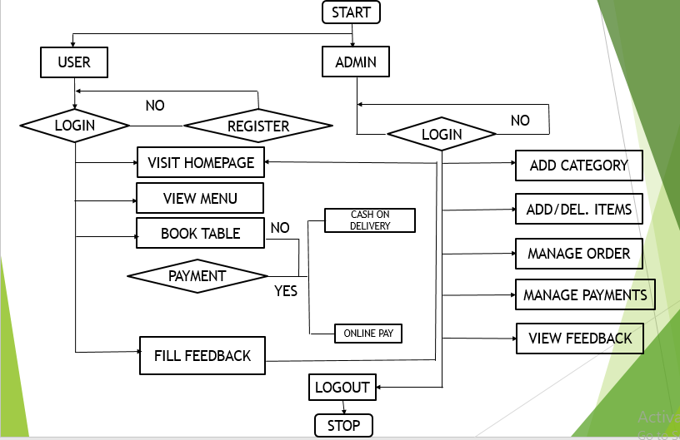
Flowchart

Slide 15

SPRING BOOT
Spring Boot provides a good platform for Java developers to develop a stand-alone and production-grade spring application that we can just run
Advantages
Spring Boot offers the following advantages to its developers −
Easy to understand and develop spring applications
Increases productivity
Reduces the development time

Slide 16
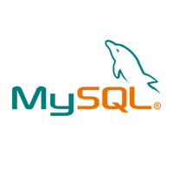
MYSQL
MySQL is a relational database management system based on the Structured Query Language, which is the popular language for accessing and managing the records in the database.
MySQL is currently the most popular database management system software used for managing the relational database.
It is open-source database software, which is supported by Oracle Company.
It is fast, scalable, and easy to use database management system in comparison with Microsoft SQL Server and Oracle Database.

Slide 17
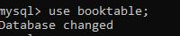
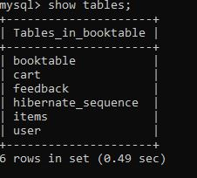
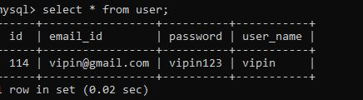
MySQL Queries

Slide 18
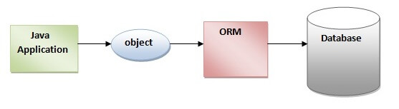
HIBERNATE
Hibernate is a Java framework that simplifies the development of Java application to interact with the database.
It is an open source, lightweight, ORM (Object Relational Mapping) tool. Hibernate implements the specifications of JPA (Java Persistence API) for data persistence.
ORM Tool
An ORM tool simplifies the data creation, data manipulation and data access. It is a programming technique that maps the object to the data stored in the database.
The ORM tool internally uses the JDBC API to interact with the database.

Slide 19

POSTMAN TOOL
Postman is one of the most popular software testing tools which is used for API testing.
With the help of this tool, developers can easily create, test, share, and document APIs.
Postman is a standalone software testing API (Application Programming Interface) platform to build, test, design, modify, and document APIs.
It is a simple Graphic User Interface for sending and viewing HTTP requests and responses.

Slide 20
Why do we use postman?
Accessibility- One can use it anywhere after installing Postman into the device by simply logging in to the account.
Use Collections-Postman allows users to build collections for their API-calls. Every set can create multiple requests and subfolders. It will help to organize the test suites.
Test development- To test checkpoints, verification of successful HTTP response status shall be added to every API- calls.
Automation Testing-Tests can be performed in several repetitions or iterations by using the Collection Runner or Newman, which saves time for repeated tests.
Creating Environments- The design of multiple environments results in less replication of tests as one can use the same collection but for a different setting.
Debugging- To effectively debug the tests, the postman console helps to track what data is being retrieved.
Collaboration- You can import or export collections and environments to enhance the sharing of files. You may also use a direct connection to share the collections.
Continuous integration-It can support continuous integration.

Slide 21
JUNIT TESTING
ANNOTATIONS OF JUNIT:
@Test annotation specifies that method is the test method.
@Test(timeout=1000) annotation specifies that method will be failed if it takes longer than 1000 milliseconds (1 second).
@BeforeClass annotation specifies that method will be invoked only once, before starting all the tests.
@Before annotation specifies that method will be invoked before each test.
@After annotation specifies that method will be invoked after each test.
@AfterClass annotation specifies that method will be invoked only once, after finishing all the tests.

Slide 22
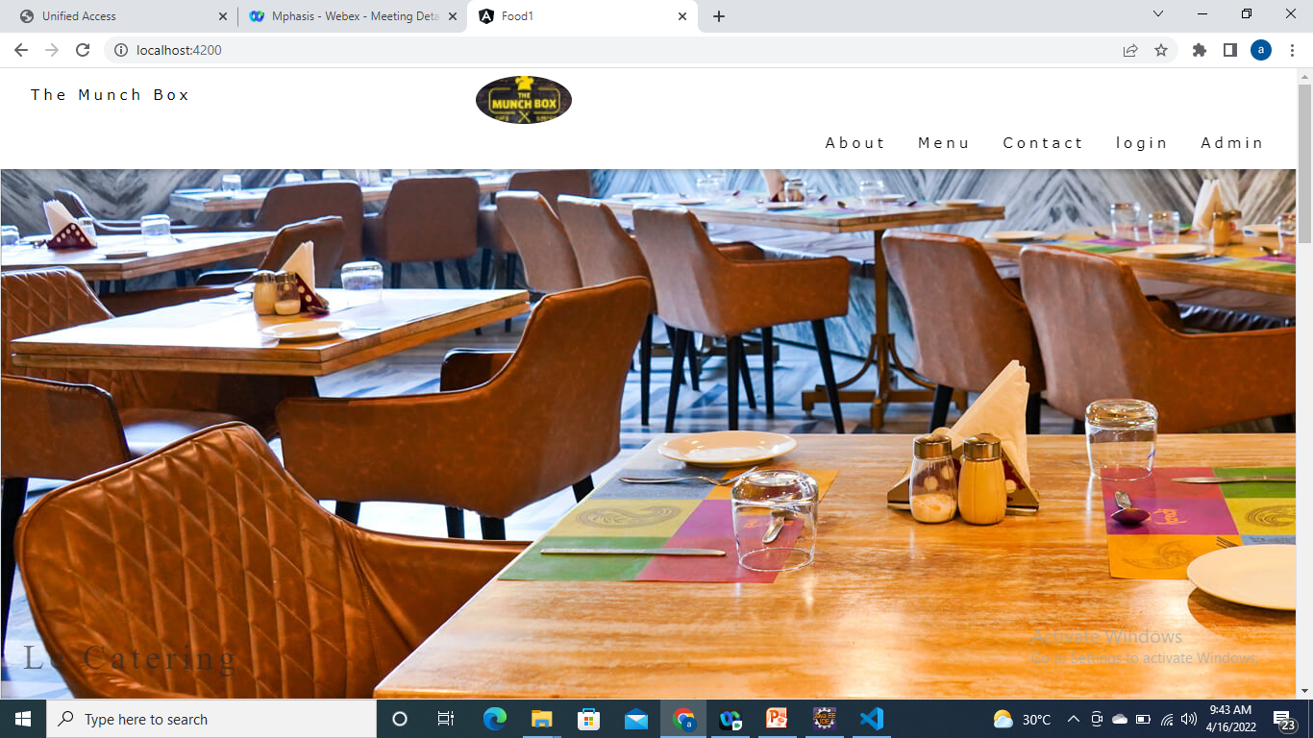
Home Page:
Screenshots Of Output

Slide 23
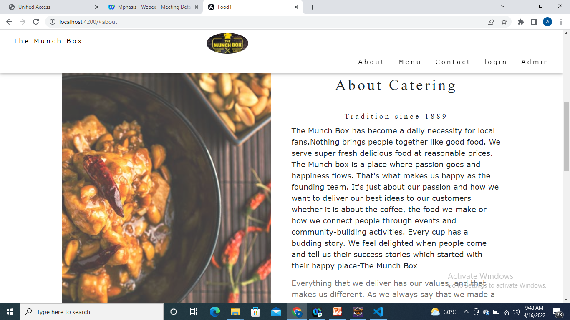
About Page:

Slide 24
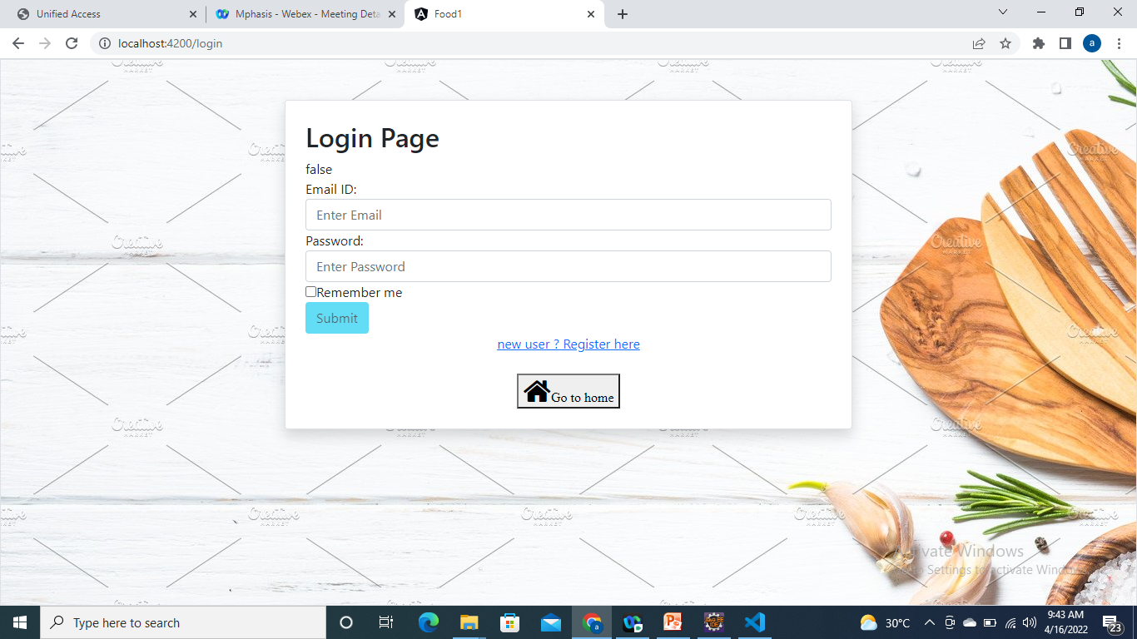
Login Page:

Slide 25
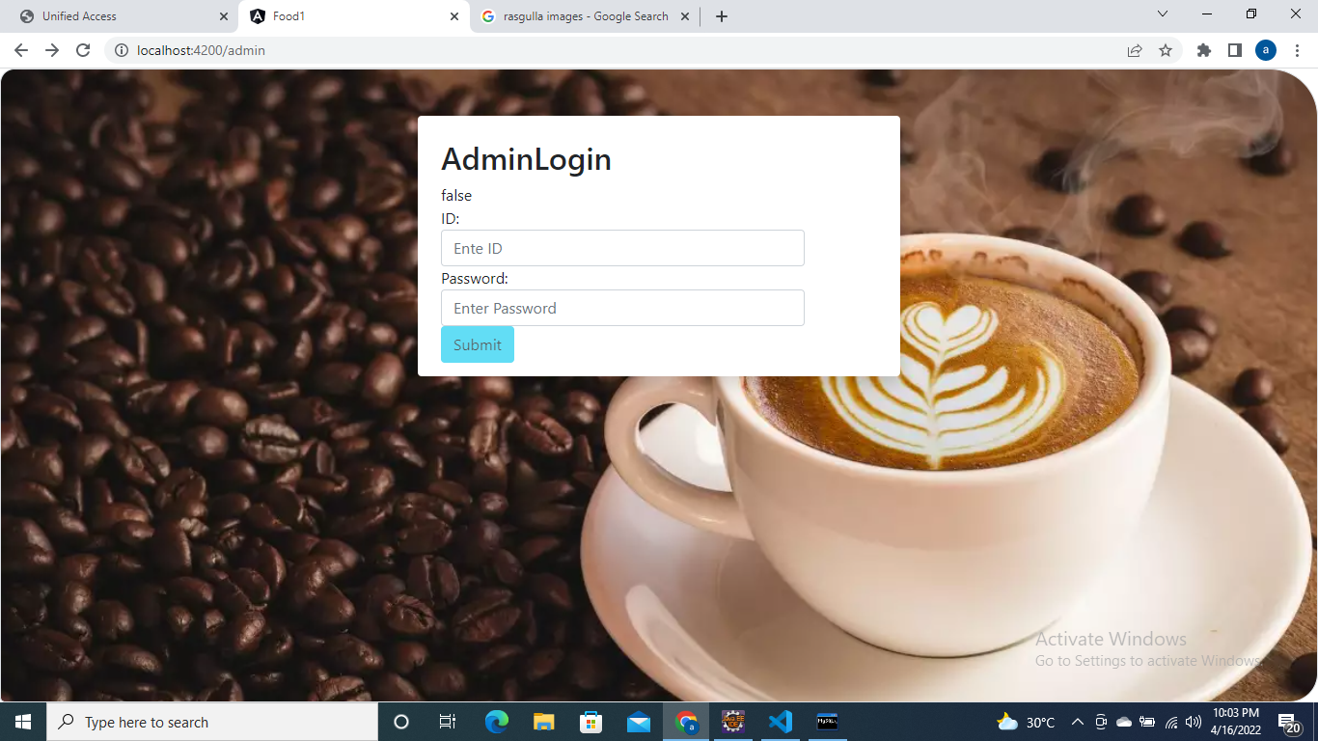
Admin Page:

Slide 26
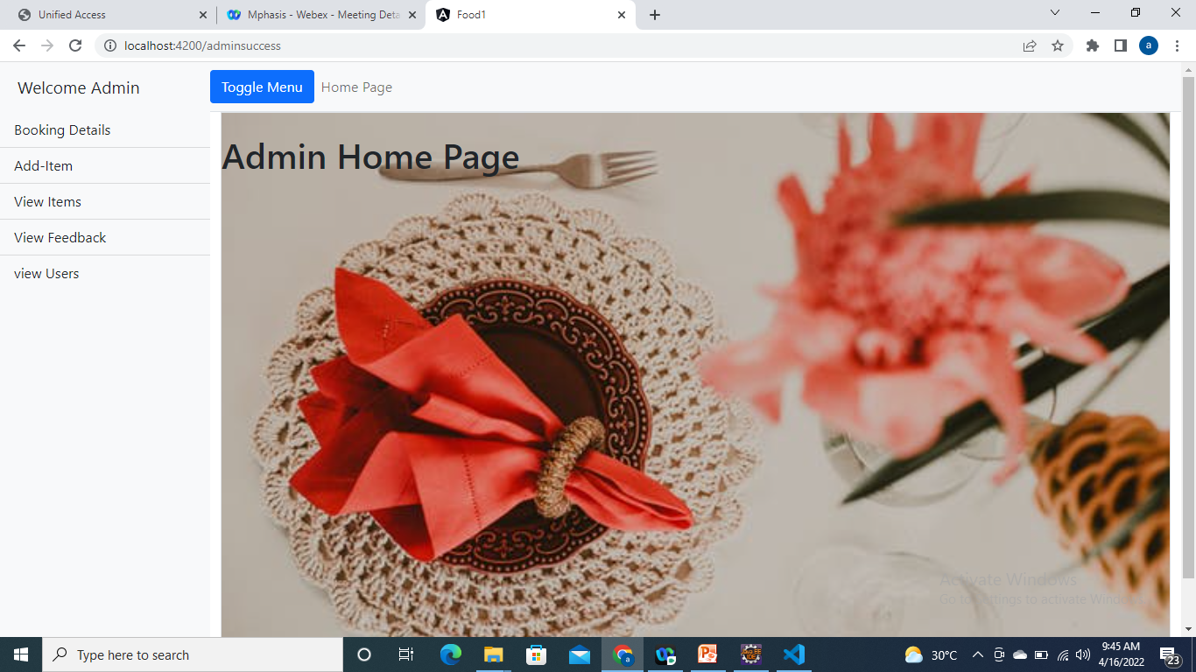
Admin Home Page:

Slide 27
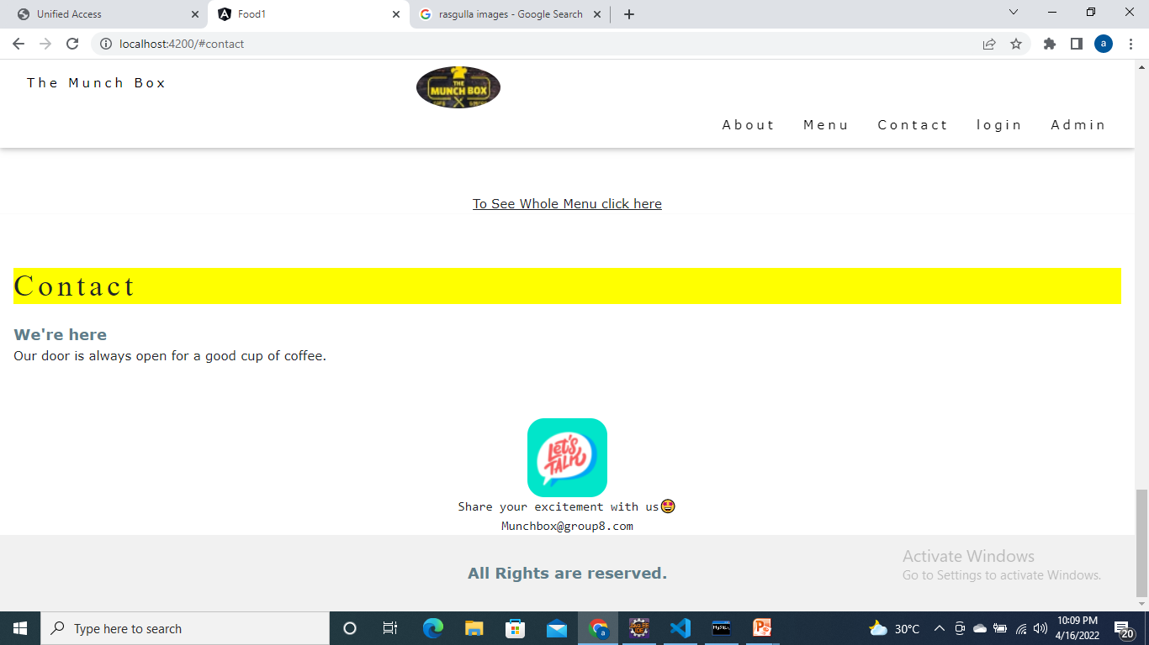
Contact Us Page:

Slide 28
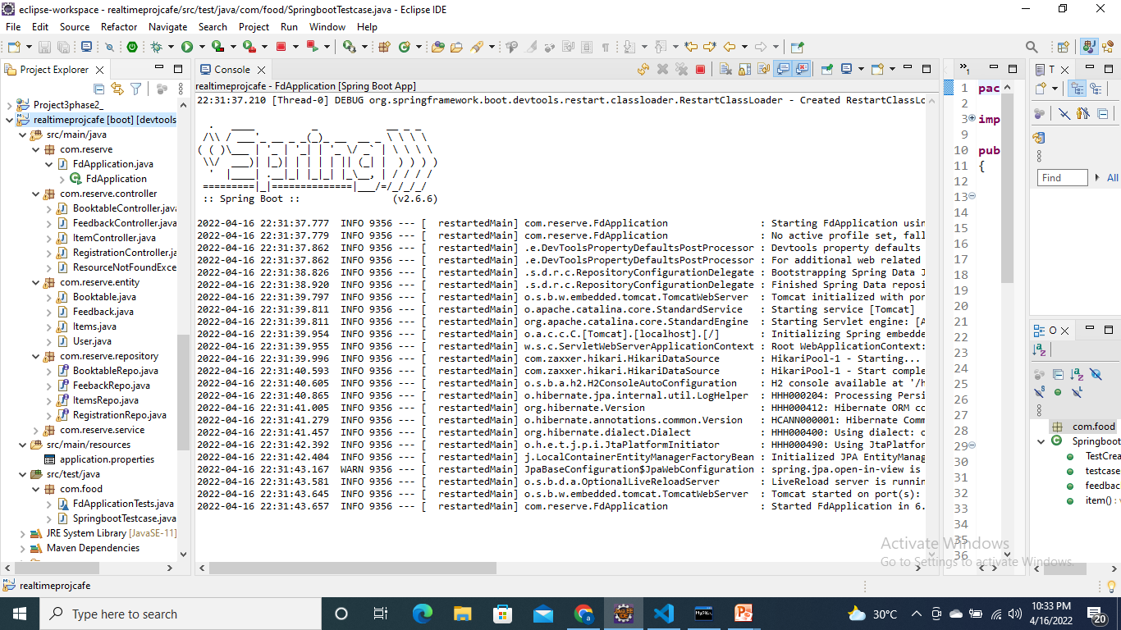

Slide 29

Features of Café Table Reservation
Easy to use.
This system is easily compatible with most of the web browsers.
Admin can view all the records whenever necessary with ease.
User-Friendly System
Easy Menu setup
Tracking sales

Slide 30

Advantages
Helps the customers to access their data.
The information related to customers can be added and removed easily.
Store the end-to-end data of the customers
Can easily update and edit menu details.

Slide 31

Disadvantages
Data security, loss and theft.
Cyber security and fraud.
Information access, quality and control

Slide 32

Future scope and improvements
The option to print the records In future.
This Application works in Multiple PC’s installed on multiple Computers but sharing Same database by which users of different department can use it sitting at different locations simultaneously.
But in future we can make the Application where the database will be hosted in order to manage the all departments which will be located in different places and by keeping domain of Application as Online.

Slide 33
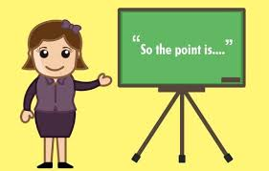
Conclusion
This project is built keeping in mind that it is to use by admin and the customers in an organization . According to the requested requirement the admin can add, manipulate, update and delete all employee data .The admin can add new customer and delete them. The required records can be easily viewed by the admin anytime time he wants in an instant. Numerous validations implemented would enable the admin to enter accurate data. The main objective of this framework is to save time, make the system cost effective and management records efficiently.

Slide 34
Sources:
www.google.com
www.javatpoint.com
www.youtube.com
www.stackoverflow.com
WWW.spring.io

Slide 35
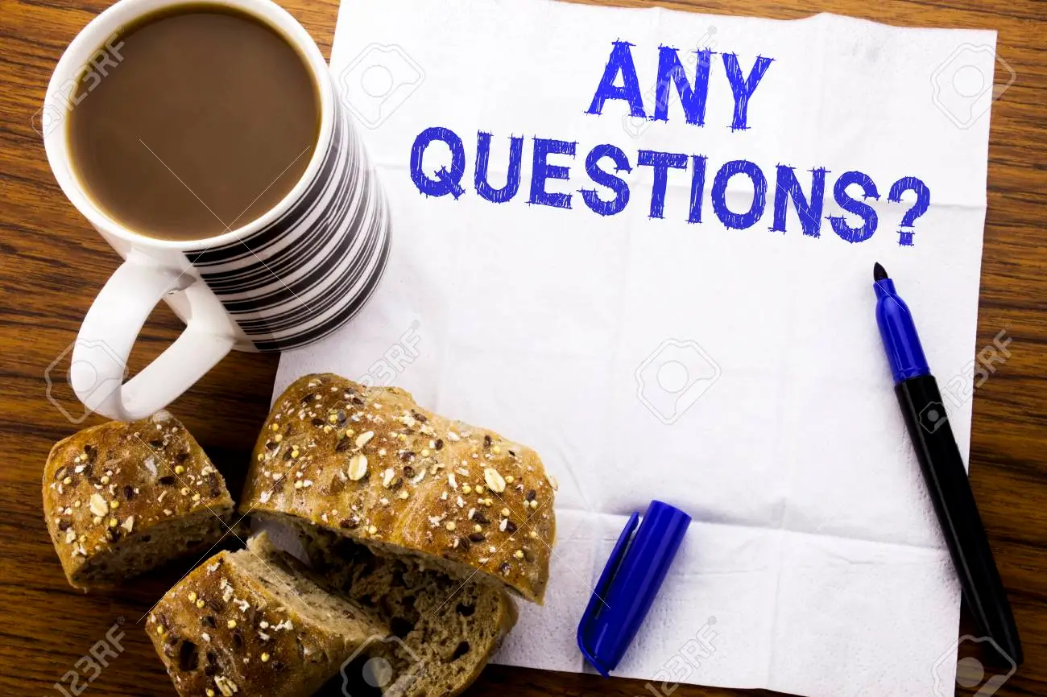

Slide 36

THANK YOU

